Slide 1
COMS 4111: Introduction to Databases Lecture 17: Midterm, Data Address Space, Buffer Mgmt., Indexes, Transactions (I)
Dr. Donald F. Ferguson
dff9@columbia.edu

Slide 2
Comments Observations

Slide 3
Midterm Grades to Date

Slide 4
Observations
Students seemed to follow one of six strategies
Put at least something down for as many questions as possible.
Focus on correctly answering one or two questions in detail.
Write down as much DDL, DML, PL-SQL as possible.
Write DDL and SQL that was amazingly precise, right down to “`” versus “’”
Write something on as many pages as possible.
Write a prose story/essay explaining the DML, DDL and diagrams that they would have/should have done.
Some students adapted to switched strategies over time/pages.
There were some very interesting and amusing comments addressed to me; At least most of us kept our sense of humor.
This exam must have been brutal; I am really sorry.

Slide 5
Grading
Grading was extremely difficult
I was looking for specific things on each question, e.g.
Inheritance: Manager → Employee → Person
Knowing simple navigation from OrderDetail→Order→Company→Address→Restricted
That 1b and 1c were much simpler if you reused the join from 1a.
Very, very few students got any of the things I was looking for.
Many students became focused on details of syntax
I mentioned repeatedly that syntax is not the focus, but …
My slides have the intricate syntax because
I test my DDL, DML, PL-SQL code before including in slides
And copying the code from the workbench or development environment
Copies the intricate details on syntax
Which must lead students to assume, from slides, that the details are important.

Slide 6
Example Inheritance

Slide 7
Datamodel Navigation
We discussed the concept
Using a table.
To define validity rules.
That an admin can set.
By adding rows to a table.
In the Tuesday review class before the midterm.
And, this was a midterm practice problem discussed on Piazza.
product_id
country (country_code)

Slide 8
Navigation
CREATE DEFINER=`root`@`localhost` FUNCTION `get_country_for_order`(o_id INT) RETURNS varchar(32) CHARSET utf8 BEGIN DECLARE answer VARCHAR(32); DECLARE c_id VARCHAR(8); DECLARE a_id VARCHAR(8); DECLARE c_code CHAR(2); SET c_id = (SELECT company_id FROM Orders WHERE Orders.order_id=o_id); SET a_id = (SELECT addressid FROM Companies WHERE Companies.company_id=c_id); SET c_code = (SELECT country_code FROM Addresses WHERE Addresses.idAddresses=a_id); SET answer=c_code; RETURN answer; END

Slide 9
Reuse View
CREATE VIEW `allwords` AS SELECT `b`.`Word` AS `word`, SUM(`b`.`Count`) AS `total` FROM (SELECT `midterm`.`janeeyre`.`Word` AS `Word`,`midterm`.`janeeyre`.`Count` AS `Count` FROM `midterm`.`janeeyre` UNION ALL SELECT `midterm`.`mobydick`.`Word` AS `Word`, `midterm`.`mobydick`.`Count` AS `Count` FROM `midterm`.`mobydick` UNION ALL SELECT`midterm`.`tomsawyer`.`Word` AS `Word`, `midterm`.`tomsawyer`.`Count` AS `Count` FROM `midterm`.`tomsawyer`) `b` GROUP BY `b`.`Word` ORDER BY `b`.`Word`
select word, total, (select count from janeeyre as a where a.word=allwords.word) as janeeyre, (select count from tomsawyer as b where b.word=allwords.word) as tomsawyer, (select count from mobydick as c where c.word=allwords.word) as mobydick from allwords;

Slide 10
Grading
The average student
“Completed” part of two questions, and then a tiny fragment of a 3rd.
Wrote a lot of DDL and drew ER-diagrams.
Almost none of the triggers, stored procedures, DML, etc. were correct.
I had take the following approach
If something you wrote made sense and demonstrated knowledge, give +1.
Examples
ER-diagram was mostly correct: +1. Diagram recognized important concept: +1.
Set of DDL was correct: +1
DML was incorrect, but demonstrated knowledge of concepts: +1
Demonstrated understanding of procedures or triggers: +1
This approach is subjective and difficult to apply rigorously and consistently.
Despite all of the issues, you demonstrated that you studied and have learned a significant amount.

Slide 11
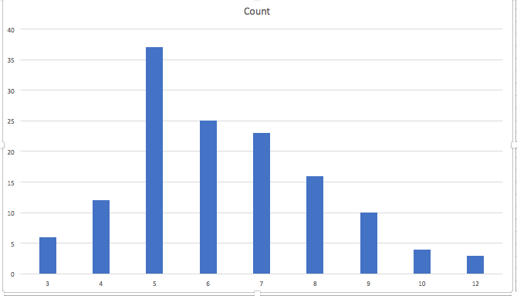
Distribution of Grades
A-
A
A+

Slide 12
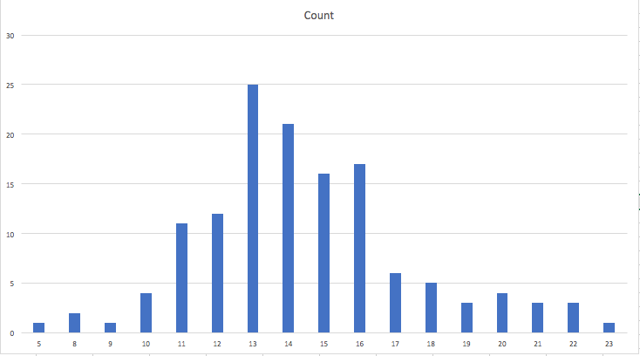
HW1, H2 and Midterm Point Distribution
Average point total is 14.4
Median is 14
Total Point out of 30

Slide 13
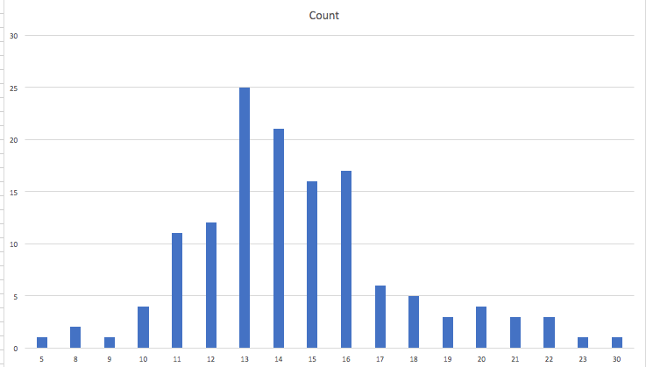
Observations
There is approximately a “bell curve”
Skewed slightly to the low end.
Extended right end tail.
This would be excellent if I wanted to
Have a C- average
Identify a very small number of As.
But, …
This is a 4xxx course in an extremely complex topic in a complex field.
HWs and exams are sensors attempting to measure knowledge.
All sensors have measurement errors and anomalies; part of education, sadly.
One-on-one conversations and office hours demonstrate to me that the HWs and midterms have unacceptably high anomaly rate: The students have learned much more than the HW and exams are showing.

Slide 14
Current Grade Status
B+
A-
A
A+
If the semester ended today, these would be final letter grades.
Total Point out of 30

Slide 15
Course Grades Going Forward
Accumulating points
HW1 + HW2 + midterm: 30 points
HW3: 10 points (completed, grading)
HW4 – Written HW, no programming: 5 points
H5, HW6: 10 points each
Final (cumulative): 35 points
Significantly different approach going forward;
HWs 4,5,6 will be simpler, more focused and contain guidance.
Final will be take some, AND we will start doing sample problems now → continuously calibrate difficulty as semester progresses.
Develop a weighting
Between HW1, HW2, HW3, midterm
HW4, HW5, HW6, final
That does lose the relatively high letter grades from HW1, HW2, HW3, midterm in overall semester point total.
Will meet with some students and the TAs to come up with a documented approach.

Slide 16
DB Address Space

Slide 17
Block and Record Addresses
Disk Room 1
Blocks and records have addresses
Index tables map an index entry to {block, record}
SELECT scan on a table needs a logical linked list of the blocks holding records, e.g. “next block.”
Index elements are themselves blocks, and need to reference other nodes in the index.
But, …
The blocks can be all over the place, and
Each “place” has a different address format and access protocol.
Disk Room 2
Cloud 1
Tape Library
Cloud 2

Slide 18
Data Address Space (Overly Simply)
The block/storage system represents block addresses with
A logical ID
That is simply a string, e.g. UUID or has some structure.
There is a logical address to physical address mapping table that maps a logical address to a physical address
Block/storage engine ID.
An opaque address string that the specific engine understands and manages.
For example, in a storage area network, the physical address might be
IP address of storage server.
ID of disk attached to the server.
{Head Number, Track, Sector}
Any reference to a block, e.g. in an index node, uses the logical address.
Figuring out where, when and why to put a block in a specific engine/domain is an important optimization function in DMBS.

Slide 19
Data Address Space (Overly Simply)
Straightforward:
s-sever11.nas.myco.com
/var/dev1
The block/storage system represents block addresses with
A logical ID
That is simply a string, e.g. UUID or has some structure.
There is a logical address to physical address mapping table that maps a logical address to a physical address
Block/storage engine ID.
An opaque address string that the specific engine understands and manages.
For example, in a storage area network, the physical address might be
IP address of storage server.
ID of disk attached to the server.
{Cylinder, Head Number, Sector}
Any reference to a block, e.g. in an index node, uses the logical address.
Figuring out where, when and why to put a block in a specific engine/domain is an important optimization function in DMBS.
Most devices surface Logical Block Addressing.

Slide 20
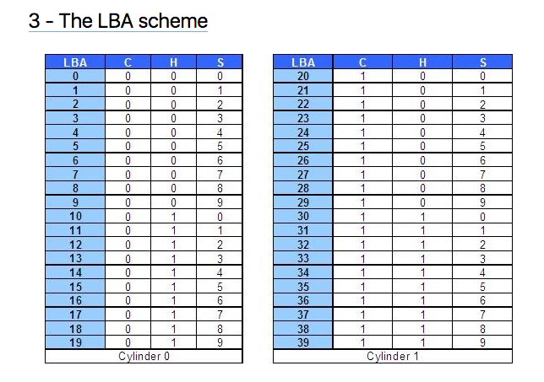
Logical Block Addressing (https://gerardnico.com/wiki/data_storage/lba)
CHS addresses can be converted to LBA addresses using the following formula:
LBA = (( C x HPC ) + H ) x SPT + S – 1
where,
C, H and S are the cylinder number, the head number, and the sector number
LBA is the logical block address
HPC is the number of heads per cylinder
SPT is the number of sectors per track
Devices have configuration and metadata APIs that allow storage manager to
Map between LBA and CHS
To optimize block placement
Based on access patterns, statistics, data schema, etc.

Slide 21
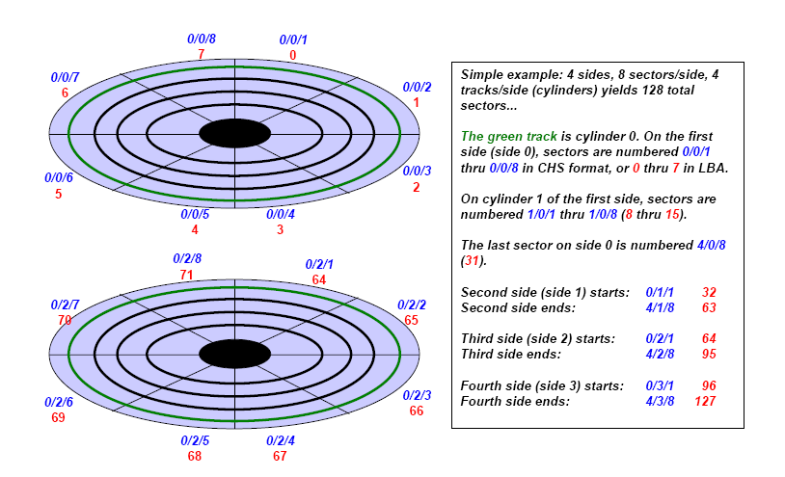
Another View (http://www.c-jump.com/CIS24/Slides/DiskDrives/D01_0150_chs_vs_lba.htm)

Slide 22
Summary
There is a broad category of storage devices
“Just a disk”
RAID-0, RAID-1, RAID-5, RAID-X/Y
Network/cloud addressable devices
SSD
A device has configuration information, often via APIs
Device geometry
Reliability metrics
IOPs, and sub-elements (seek, rotate, etc).
Storage management consists of using statistics and query (optimization patterns) to
Arrange records into blocks for storage and IO efficiency.
Place blocks on devices at LBAs to meet performance and IO objectives.

Slide 23
Buffer Pools

Slide 24
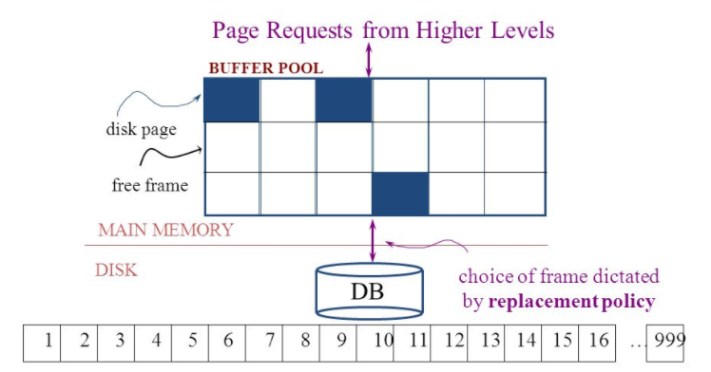
The Logical Concept
The DBMS and queries can only manipulate in-memory blocks and records.
A very, very, very small fraction of all blocks fit in memory.
Memory is a set of frames, each of which can hold exactly one block (AKA disk page).
A block/frame is pinned, if being accessed by an executing query/operation.

Slide 25
Replacement Policy
The replacement policy is one of the most important factors in database management system implementation and configuration.
A very simple, introductory explanation is (https://en.wikipedia.org/wiki/Cache_replacement_policies).
There are a lot of possible policies.
The most efficient caching algorithm would be to always discard the information that will not be needed for the longest time in the future. This optimal result is referred to as Bélády's optimal algorithm/simply optimal replacement policy or the clairvoyant algorithm.
All implementable policies are an attempt to approximate knowledge of the future based on knowledge of the past.
Least Recently Used is based on the simplest assumption
The information that will not be needed for the longest time.
Is the information that has not been accessed for the longest time.

Slide 26
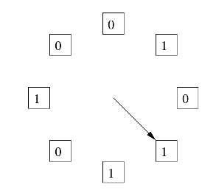
The “Clock Algorithm”
LRU is (perceived to be) expensive
Maintain timestamp for each block.
Update and resort blocks on access.
The “Clock Algorithm” is a less expensive approximation.
Arrange the frames (places blocks can go) into a logical circle like the seconds on a clock face.
Each frame is marked 0 or 1.
Set to 1 when block added to frame.
Or when application accesses a block in frame.
Replacement choice
Sweep second hand clockwise one frame at a time.
If bit is 0, choose for replacement.
If bit is 1, set bit to zero and go to next frame.
The basic idea is. On a clock face
If the second hand is currently at 27 seconds.
The 28 second tick mark is “the least recently touched mark.”

Slide 27
Buffer Management Algorithm
The replacement algorithms are more sophisticated in the real world, e.g.
“Scans” are common, e.g. go through a large query result in order (will be more clear when discussing cursors).
The engine knows the current position in the result set.
Uses the sort order to determine which records will be accessed soon.
Tags those blocks as not replaceable.
(A form of clairvoyance).
Not all users/applications are equally “important.”
Classify users/applications into priority 1, 2 and 3.
Sub-allocate the buffer pool into pools P1, P2 and P3.
Apply LRU within pools and adjust pool sizes based on relative importance.
This prevents
A high access rate, low-priority application from taking up a lot of frames
Result in low access, high priority applications not getting buffer hits.
Future access patterns are predictable based on statistics and query plans → pre-read and prefetch is also possible.

Slide 28
Summary
Like all other aspects of DMBS implementation
Block management
Buffer management
Are incredibly complex, heavily researched topics.
This course section has just skimmed the surface
Awareness of concepts.
Foundation for future more advanced courses.
Understand concepts to consider, research, prototype, etc. if you have to implement your own data management engine.

Slide 29
Indexes

Slide 30
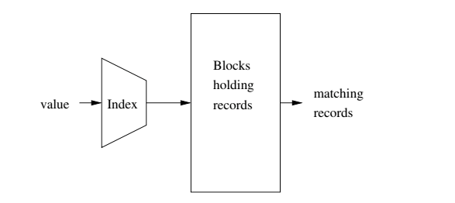
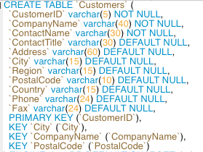
Index
Block will map to
In memory block in frame.
Address in Data Address Space.
Column values or set of column values.
Garcia-Molina et al.
Indexes are created on
Simple keys = e.g. a single column.
Composite keys = a set of columns, e.g. (last_name, first_name)
Index can be unique/non-unique, dense/sparse, clustered/unclustered, ordered/hashed.

Slide 31
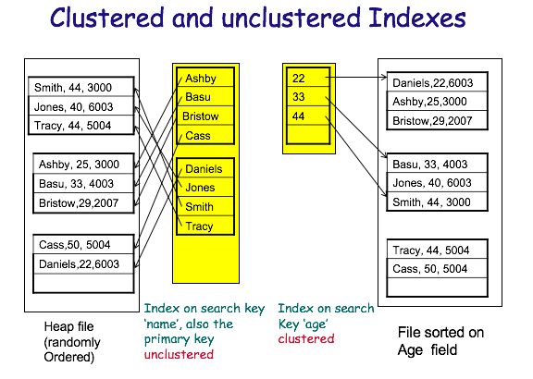
Clustered vs Unclustered
Order of keys in index is approximately the same as order of records in file.

Slide 32
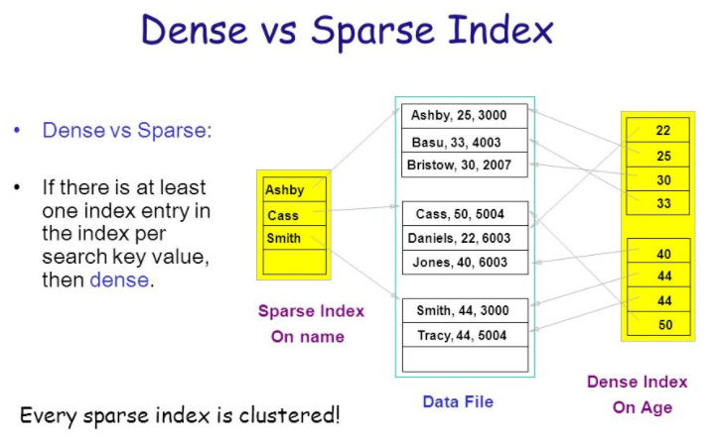
Dense versus Sparse Index
“Storage and File Structure. Architecture of a DBMS,” Shona Holmes.
http://slideplayer.com/slide/6841281/

Slide 33
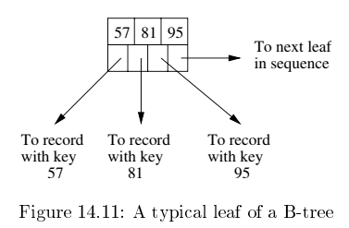
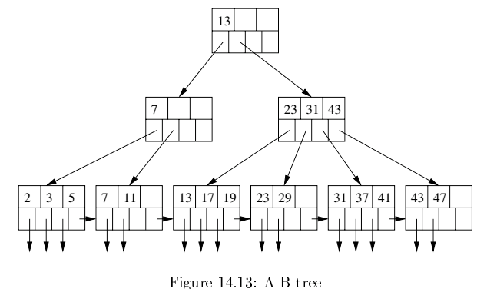
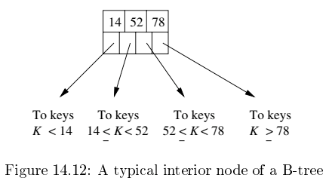
B-Tree
Based on concept of a binary search tree, but with two core modifications
Unit of transfer to/from memory is a block, which will hold many (key,record) maps.
Accessing records in order (WRT to index) is common → clustering is common.

Slide 34
Sample Exam Problem

Slide 35
Midterm Problem 3
Design a multi-tenant contact management database. A contact has a last_name, first_name and email. A contact has 0 or more addresses. An address is of the form Address(street number, street name, city, postal code, country). All addresses have a pre-defined label relative to a person, e.g. “Home”, “Work”, “Business”. A contact also has one or more phone_numbers. All phone numbers have a pre-defined label with respect to a contact, e.g. “Cell”, “Home”. The administrator for a specific tenant can define which pre-defined address and phone labels are allowed in their data items in the database.
All queries (SELECT, INSERT, UPDATE, DELETE) must have a way of specifying which tenant is submitting a request. Queries can only return or manipulate a specific tenant’s data. Associating an address or phone number with a contact can only use the labels allowed for the tenant.

Slide 36
Midterm Q3 -- Multitenant
The term "software multitenancy" refers to a software architecture in which a single instance of software runs on a server and serves multiple tenants. A tenant is a group of users who share a common access with specific privileges to the software instance. With a multitenant architecture, a software application is designed to provide every tenant a dedicated share of the instance - including its data, configuration, user management, tenant individual functionality and non-functional properties. Multitenancy contrasts with multi-instance architectures, where separate software instances operate on behalf of different tenants. ^{[1]}
Some commentators regard multitenancy as an important feature of cloud computing.

Slide 37
Multitenant

Slide 38
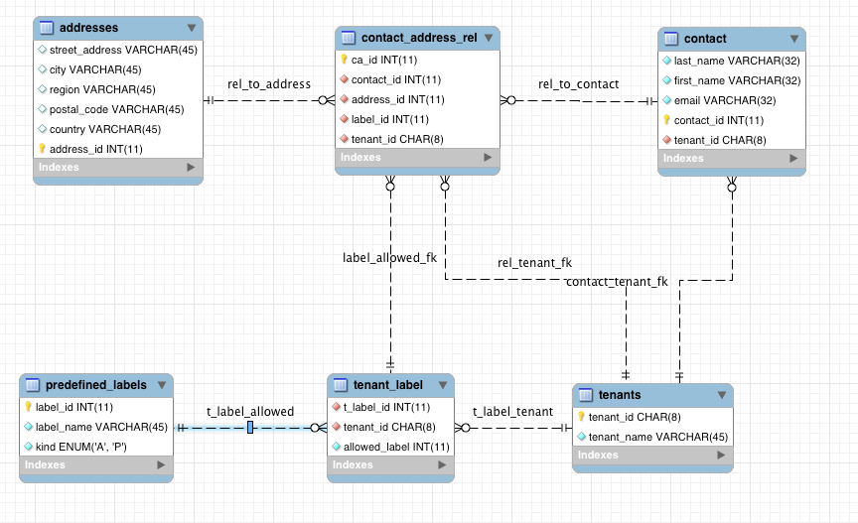
ER Diagram

Slide 39
DDL and Queries

